Slide 1
Data Cleaning, Part I
CS3300 Data Science
RJ Nowling

Slide 2
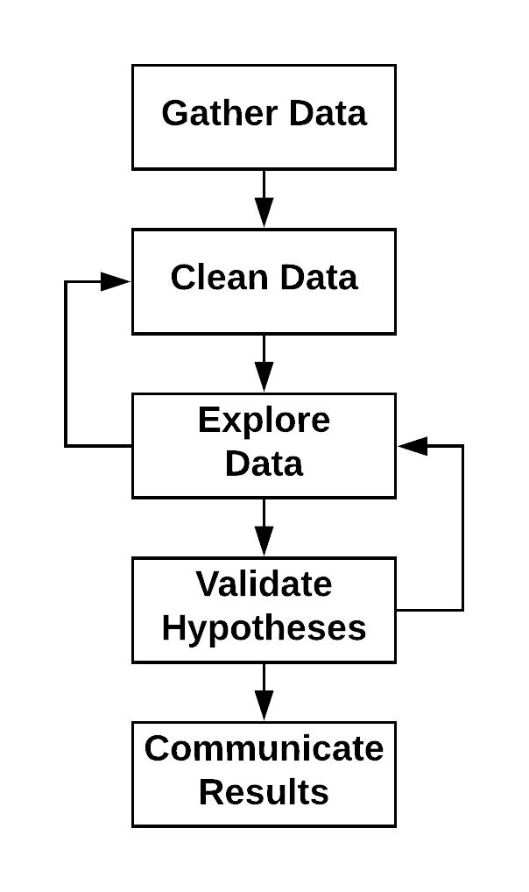
Data Science Process
Application of the scientific method to data
Data Science vs Machine Learning
Data Science: Understand the data and its Relationships better. Uses machine learning to explore data and validate those relationships
Machine Learning: Goal is to build a predictive model. Data Science is used to identify variables for the models and evaluate the models by creating an experimental framework

Slide 3
Data Cleaning Steps
Parse the file format to read in the data. At the end of this stage, for each record, you should be able to separate the values belonging to each field
Convert data to consistent representations (e.g., spelling of state names, format of dates)
Convert values to the right types (e.g., floats, datetimes, categorical)
Convert values to the right units (e.g., everything in inches)
Remove outlier records

Slide 4
Structuring Data

Slide 5
Properly Structured Data
After we acquire the data, we need to clean it
A clean data set is organized into a table such that:
Each sample is one row
Each variable is one column
All values are represented by their proper type (e.g., datetime, float, categorical)
All values in each column have the same types (e.g., int, float)
All values in each column have the same units (e.g., inches)

Slide 6
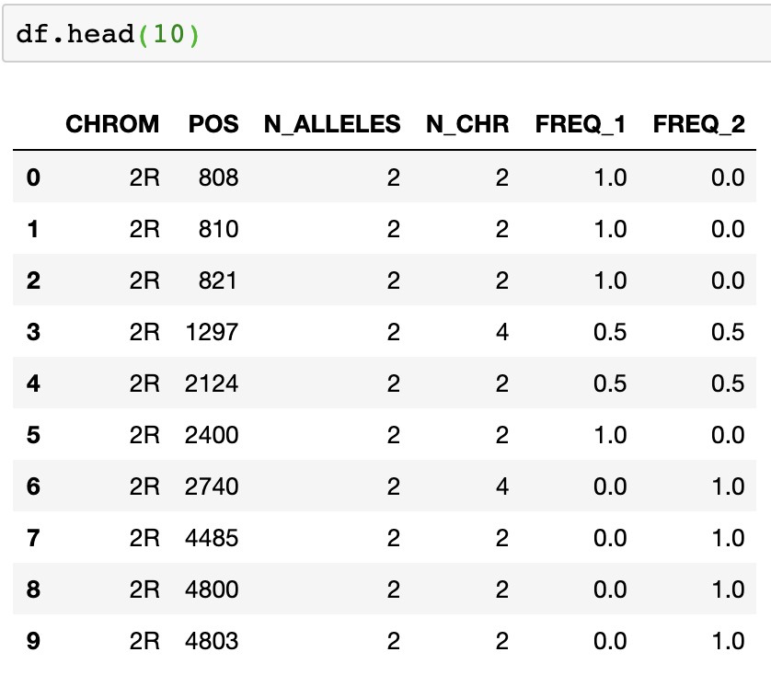
Representing Data as a Table

Slide 7
Observations are in Rows

Slide 8
Variables are in Columns

Slide 9
Loading Data

Slide 10
Loading Data with Pandas
Before we can access the data in a file, we need to be able to read it
Generally, you can use:
df = pd.read_csv() – read a CSV or TSV file
df = pd.read_json() – read a JSON file
df = pd.read_excel() – read an Excel file
df = pd.read_sql() – read a result of a SQL query or table
This only works if the file formats are properly formatted or the data is available in common file formats

Slide 11
Bad or Uncommon File Formats
Files may have bad formats for multiple reasons
Excel spreadsheet doesn't strictly organize data into a single table of columns and rows
Someone wrote a custom JSON writer and didn't escape newlines and quote (") marks in Strings properly
Data is from multiple sources and written in a mix of encodings (e.g., UTF-8) in the same file
Files may also be in uncommon file formats
e.g., domain-specific file formats like FASTA and VCF for genomic data

Slide 12
Loading Data (incorrectly)

Slide 13
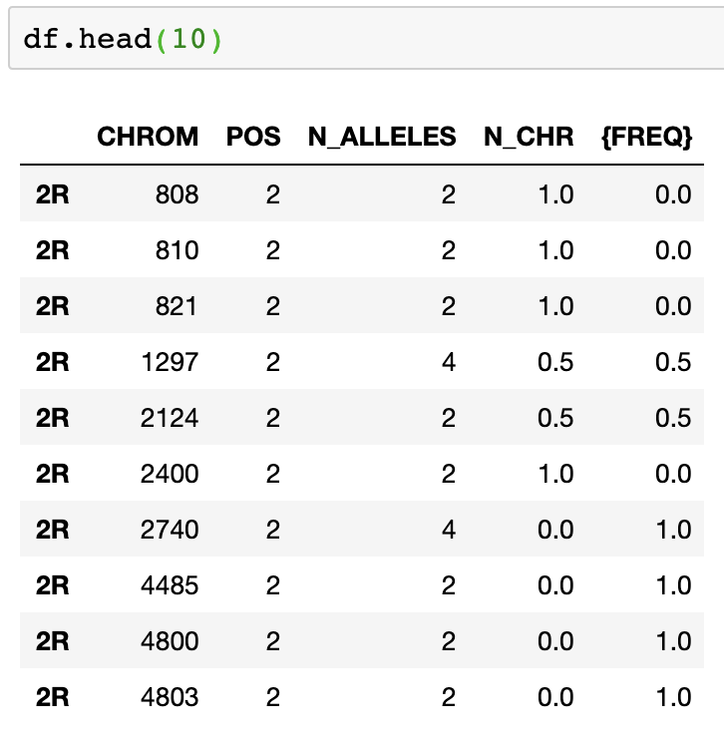
Incorrectly Read Data

Slide 14
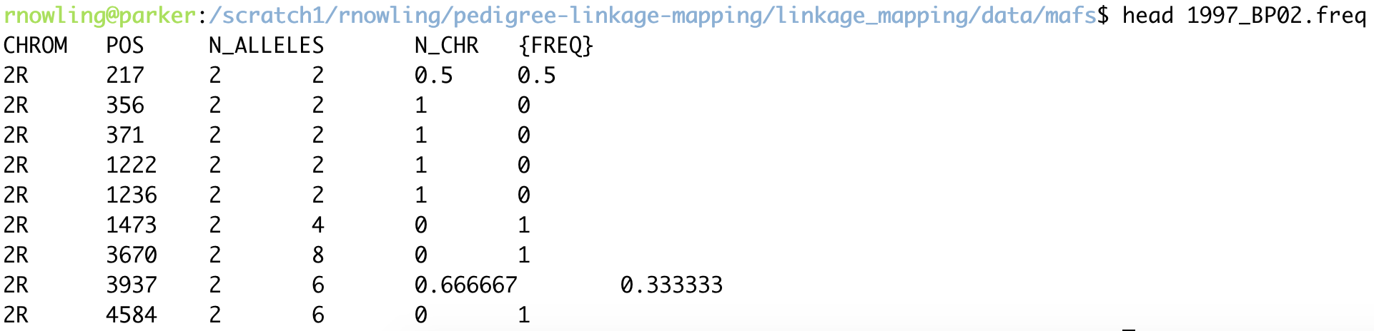
Raw Text File

Slide 15
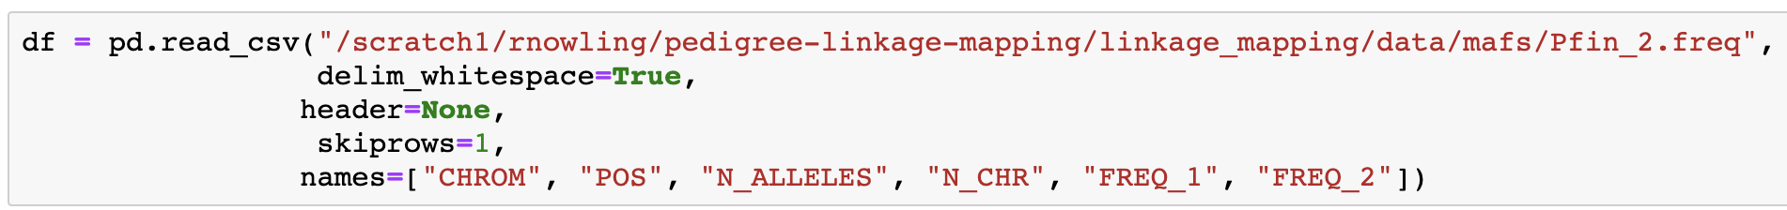
Loading Data (correctly)

Slide 16
Correctly Read Data

Slide 17
Custom Parsers
In some cases, you will need to write custom code to read a file format and create the DataFrame yourself
Store the data in lists (one per column)
And create a DataFrame yourself: df = pd.DataFrame({ "column1" : column1, "column2" : column2 })

Slide 18
Custom Parsers
You can also create DataFrames from a list of tuples
rows = []
for ln in fl:
...
rows.append((value1, value2, value3))
df = DataFrame.from_records(rows,
columns=["col_1", "col_2",
"col_3"])

Slide 19
Basic Data Exploration

Slide 20
Look at Your Data!
Look at the first few records (head() on the table)
Use Pandas' info() method to get column info (e.g., name, type, nulls)
Use Pandas' describe() method to get descriptive / summary statistics:
Average / mean
Standard deviation
Min, Max
Count, unique, mode for categorical types

Slide 21
Head

Slide 22
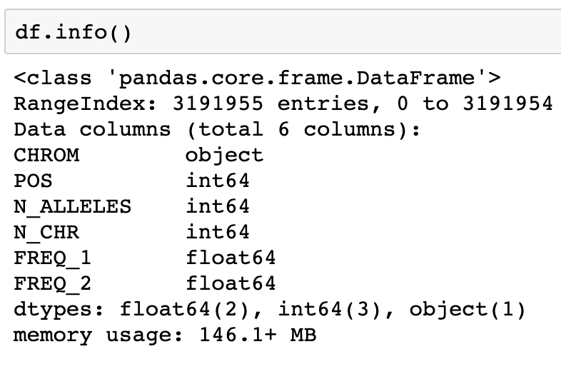
Info

Slide 23
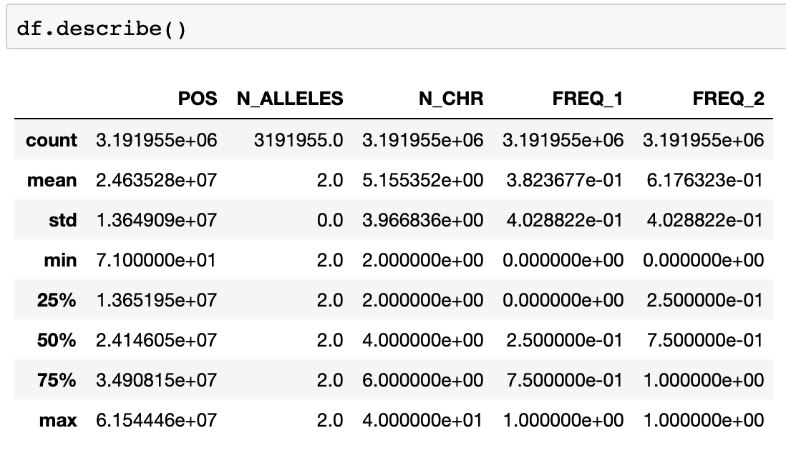
Describe

